Slide 1

Credit Card Uptake
What factors affect Credit Card uptake?
What can we do next year to increase uptake?
Notes:
A highstreet bank has called in a wizard team of data analysts to help them analyse their credit card marketing campaign.
They want to understand which types of customers respond positively to the campaign and what type of marketing is most successful.
We received a data set of 18000 records from a previous campaign. This included information about account details over a year, demographic and customer segments as well as information about what type of campaign each customer received.

Slide 2
Our Methodology
Cleaning and wrangling the data in Python - Changed data types. Numerical to Categorical - Dropped quarterly balance columns
Visualising the data. - Looking for determining factors in people’s likelihood of saying ‘Yes’ (mainly Tableau)
By customer type/activity
By type of campaign sent
Running Logisitc Regression and KNN analysis + improvement loops - Could we accurately predict uptake AND identify factors that affected those predictions?

Slide 3
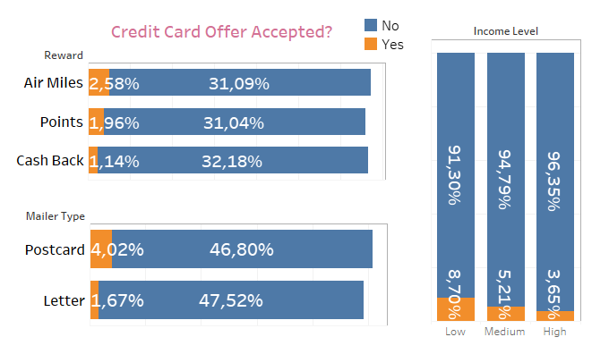
Findings 1. Top 3 ‘types’ with higher uptake:
Notes:
Recommendations
Consider sending more postcards and increasing Air Miles as a reward type.
Target lower and medium earners?
Think of new approaches to higher income groups?

Slide 4
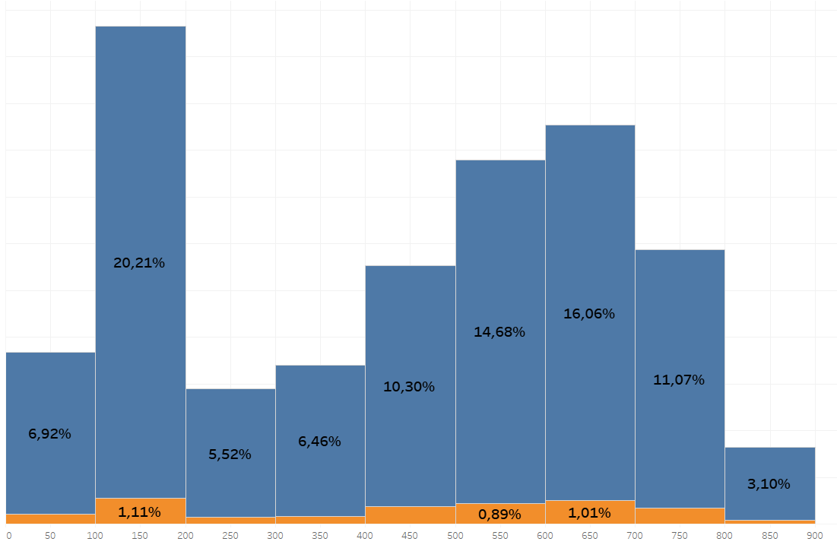
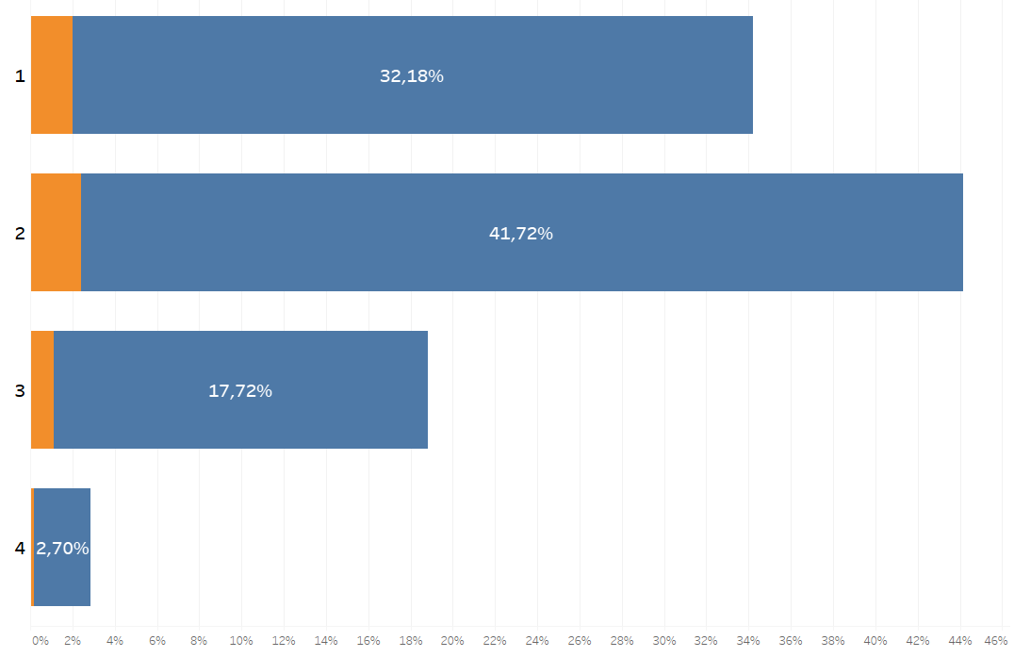
Findings 2. Some other trends
Slightly less likely to accept offer, the more credit cards you already have:
Slightly increased uptake for customers with less ‘stable’ bank balances (stdev across 4 quarters)

Slide 5
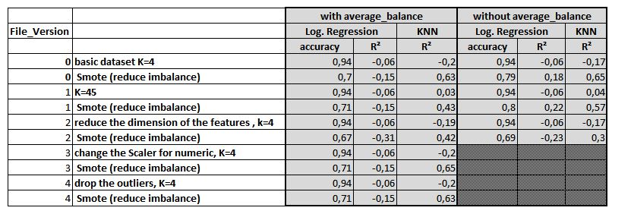
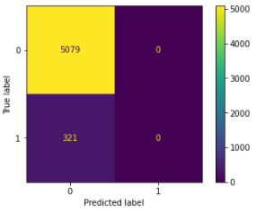
Findings 3. Hard to get useful stats from ML where data is so biased towards one outcome:
We try different steps to improve our model.
Our best model:
Confusion Matrix before SMOTE

Slide 6
Learnings - what went well. What we would do differently.
Went well
Good overview and handling of the data in early stages
Good time keeping
Would do differently
Next time we would complete the visualisation in Tableau first, before attempting Machine Learning.
Trust the data! - time wasted double-checking visualisations in Tableau

Slide 7
QUESTIONS?

